Slide 1
Major Md. Ferdausur Rahman, PhD
Associate Professor
Dept. of Sc & Hum, Military Institute of Science and Technology (MIST),
Mirpur Cantonment, Dhaka-1216, Bangladesh.
Mobile :0088 01769024146
E-mail : ferdaus806@gmail.com
majorferdausmist@gmail.com

Slide 2



WILEY
IFRS EDITION
Prepared by
Coby Harmon
University of California, Santa Barbara
Westmont College

Slide 3

ACCOUNTING IN ACTION
Learning Objectives
After studying this chapter, you should be able to:
[1] Explain the history and meaning of accounting.
[2] Identify the users and uses of accounting.
[3] Understand why ethics is a fundamental business concept.
[4] Explain generally accepted accounting principles.
[5] Explain the monetary unit assumption and the economic entity assumption.
[6] State the accounting equation, and define its components.
[7] Analyze the effects of business transactions on the accounting equation.
[8] Understand the four financial statements and how they are prepared.

Slide 4
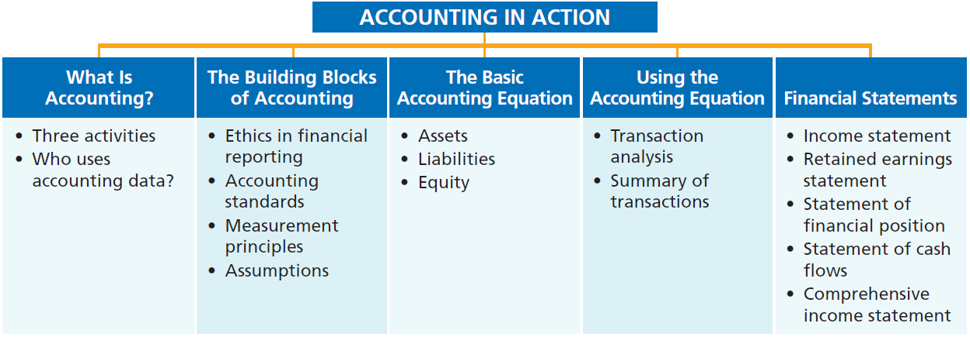
PREVIEW OF CHAPTER 1

Slide 5
HISTORY AND MEANINGOF ACCOUNTING
Accounting is very old and most important subject. The word “ACCOUNT” has come from the Latin words “ad” + “computere” which means to reckon together. The word “reckon” means to count up, compute or calculate.
The word ACCOUNTANT has come from the older English word accomptant. This word come from the French word compter which comes from the Latin word computare – to reckon, count, number
LO 1 Explain what accounting is.

Slide 6
HISTORY AND MEANINGOF ACCOUNTING
He said, “O Adam, tell them their
names.” And when he told them their
names, He said, “Did I not tell you
that I know the secrets of the
heavens and the earth, and that I
know what you reveal and what you
conceal?”
---- Al Quran-02:33

Slide 7
HISTORY AND MEANINGOF ACCOUNTING
So it can be easily said that It is also the most important part of life for each and everybody. From beggar to king, from poor to rich, from illiterate to higher educated, nobody can avoid it. On the other hand, accounting is directly related with financial or economic events (earnings & expenses). So we cannot pass a single moment without accounting. Say I am conducting a class here and using board, marker, electricity, furniture, etc. Everything has some cost or financial value. So many financial events are happening in this class room.

Slide 8
HISTORY AND MEANINGOF ACCOUNTING
In 1494, the first book on double-entry accounting was published by Luca Pacioli as the "Father of Accounting," . The first accounting book actually was one of five sections in Pacioli's mathematics book titled
SUMMA DE ARITHMETICA, GEOMETRIA, PROPORTIONI ET PROPORTIONALITA
(Everything About Arithmetic, Geometry and Proportions)

Slide 9
WHAT IS ACCOUNTING?
Accounting is an information system that identifies, records and communicates the economic events of an organization to interested users.
Purpose of accounting is to:
identify,
record, and
communicate
the economic events of an organization to interested users.
LO 1 Explain what accounting is.

Slide 10
HISTORY AND MEANINGOF ACCOUNTING
O you who believe! When you
incur debt among yourselves for a
certain period of time, write it down.
And have a scribe write in your
presence, in all fairness. And let no
scribe refuse to write, as ALLAH has
taught him. So let him write, and let
the debtor dictate. And let him fear
ALLAH, his Lord, and diminish nothing
from it.
---- Al Quran-02:282

Slide 11
What is Accounting?
Learning Objective 1 Explain what accounting is.
Accounting consists of three basic
activities—it
identifies,
records, and
communicates
the economic events of an organization to interested users.
LO 1

Slide 12
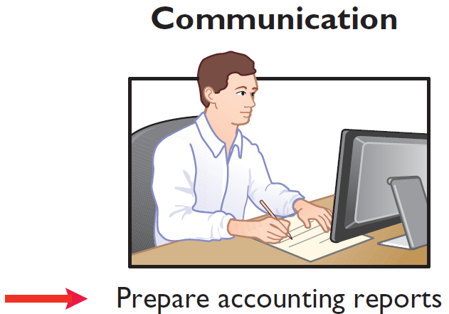
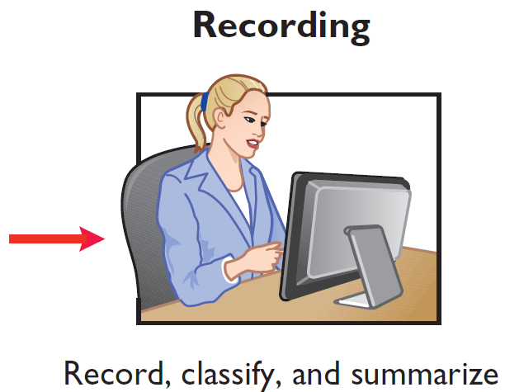
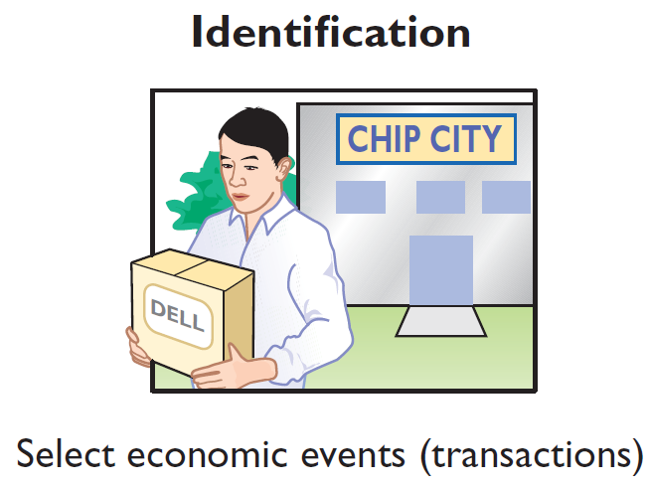
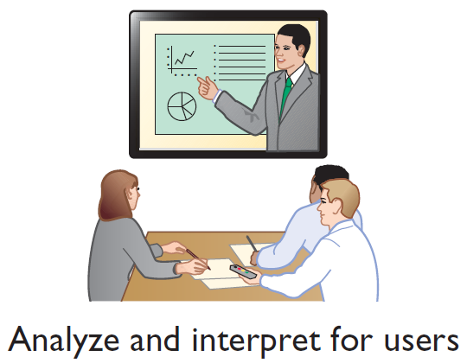
Three Activities
Illustration 1-1
The activities of the accounting process
The accounting process includes
the bookkeeping function.
LO 1

Slide 13
Assumptions
Review Question
Which of the following is not a step in the accounting process?
Identification.
Recording.
Economic entity.
Communication
LO 1

Slide 14
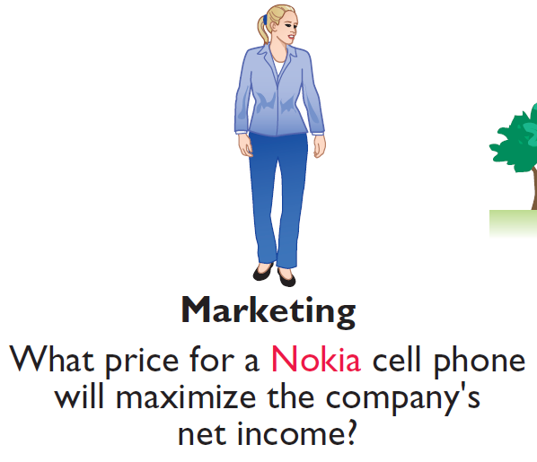
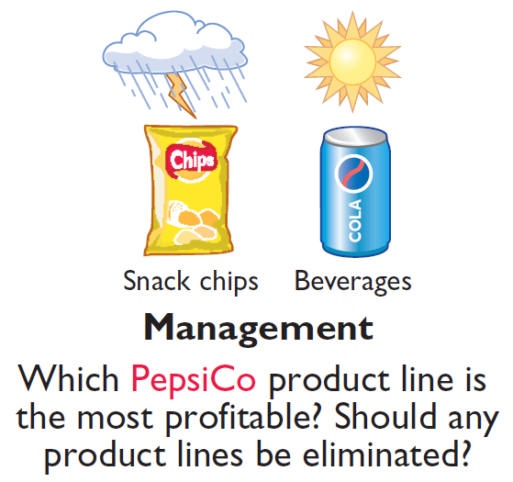
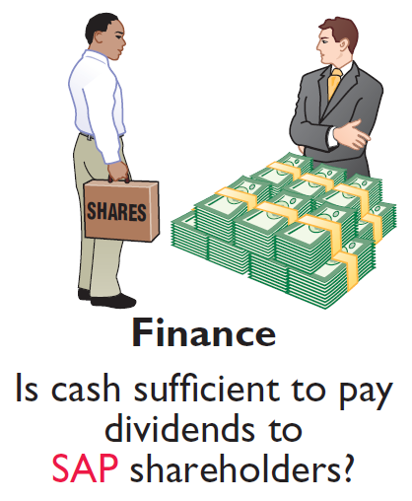
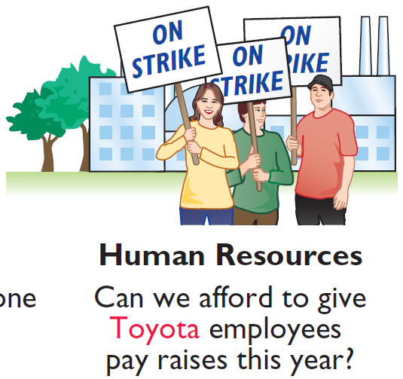
Who Uses Accounting Data?
INTERNAL USERS
Illustration 1-2
Questions that internal users ask
LO 1

Slide 15
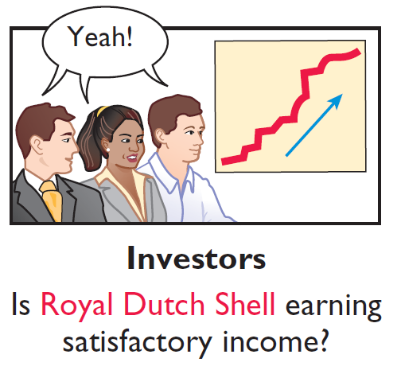
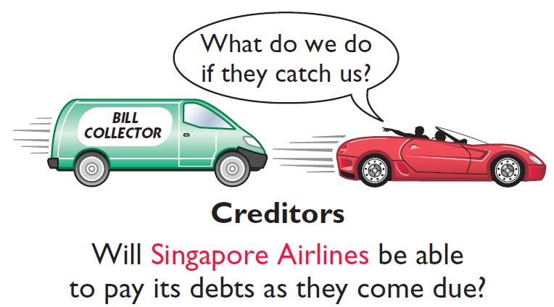
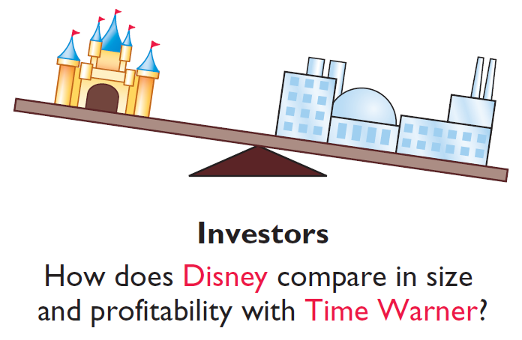
Who Uses Accounting Data?
Learning Objective 2 Identify the users and uses of accounting.
EXTERNALUSERS
Illustration 1-3
Questions that external users ask
LO 2

Slide 16
>
DO IT!
Indicate whether the following statements are true or false.
The three steps in the accounting process are identification, recording, and communication.
Bookkeeping encompasses all steps in the accounting process.
Accountants prepare, but do not interpret, financial reports.
The two most common types of external users are investors and company officers.
Managerial accounting activities focus on reports for internal users.
True
False
False
False
True
Solution: 1. 2. 3. 4. 5.
LO 2

Slide 17
The Building Blocks of Accounting
Learning Objective 3 Understand why ethics is a fundamental business concept.
Ethics in Financial Reporting
Standards of conduct by which one’s actions are judged as right or wrong, honest or dishonest, fair or not fair, are ethics.
Recent financial scandals include: Enron (USA), Parmalat (ITA), Satyam Computer Services (IND), AIG (USA), and others.
Effective financial reporting depends on sound ethical behavior.
LO 3

Slide 18
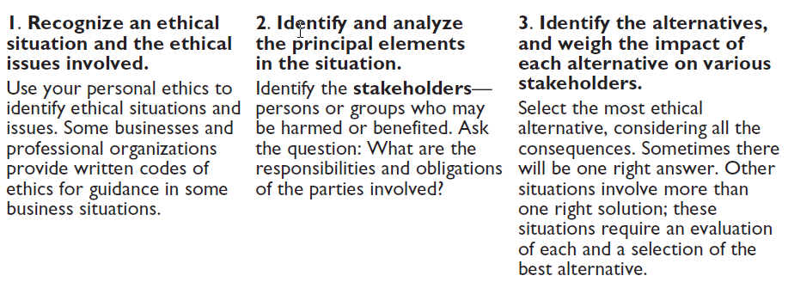
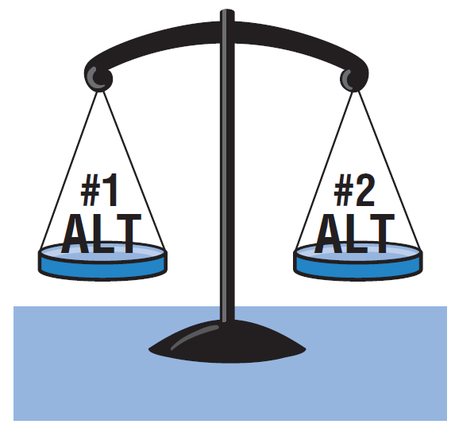
Ethics in Financial Reporting
Illustration 1-4
Steps in analyzing ethics cases and situations
LO 3

Slide 19
Ethics Insight
Dewey & LeBoeuf (USA)
I Felt the Pressure—Would You?
“I felt the pressure.” That’s what some of the employees of the now-defunct law firm of Dewey & LeBoeuf LLP (USA) indicated when they helped to overstate revenue and use accounting tricks to hide losses and cover up cash shortages. These employees worked for the former finance director and former chief financial officer (CFO) of the firm. Here are some of their comments:
• “I was instructed by the CFO to create invoices, knowing they would not be sent to clients. When I created these invoices, I knew that it was inappropriate.”
• “I intentionally gave the auditors incorrect information in the course of the audit.”
(continued)
LO 3

Slide 20
Ethics Insight
Dewey & LeBoeuf (USA)
I Felt the Pressure—Would You?
What happened here is that a small group of lower-level employees over a period of years carried out the instructions of their bosses. Their bosses, however, seemed to have no concern as evidenced by various e-mails with one another in which they referred to their financial manipulations as accounting tricks, cooking the books, and fake income.
Source: Ashby Jones, “Guilty Pleas of Dewey Staff Detail the Alleged Fraud,” Wall Street Journal (March 28, 2014).
LO 3

Slide 21


Accounting Standards
Learning Objective 4 Explain accounting standards and the measurement principles.
International Accounting Standards Board (IASB) http://www.iasb.org/
International Financial Reporting Standards
Financial Accounting Standards Board (FASB) http://www.fasb.org/
Generally Accepted Accounting Principles (GAAP)
LO 4

Slide 22
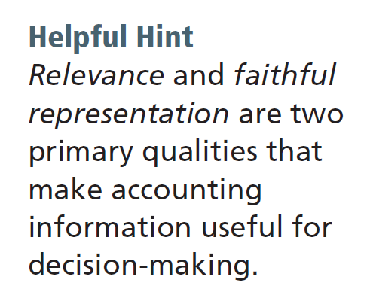
Measurement Principles
HISTORICAL COST PRINCIPLE (or cost principle) dictates that companies record assets at their cost.
FAIR VALUE PRINCIPLE states that assets and liabilities should be reported at fair value (the price received to sell an asset or settle a liability).
LO 4

Slide 23
Global Insight
The Korean Discount
If you think that accounting standards don’t matter, consider recent events in South Korea. International investors expressed concerns that the financial reports of some South Korean companies were inaccurate. Accounting practices sometimes resulted in differences between stated revenues and actual revenues. Because investors did not have complete faith in the accuracy of the numbers, they were unwilling to pay as much for the shares of these companies relative to shares of comparable companies in different countries. This difference in share price was referred to as the “Korean discount.” In response, Korean regulators decided to require companies to comply with international accounting standards. This change was motivated by a desire to “make the country’s businesses more transparent” in order to build investor confidence and spur economic growth. Many other Asian countries, including China, India, Japan, and Hong Kong, have also decided either to adopt international standards or to create standards that are based on the international standards.
Source: Evan Ramstad, “End to ’Korea Discount’?” Wall Street Journal (March 16, 2007).
LO 4

Slide 24
Assumptions
Learning Objective 5
Explain the monetary unit assumption and the economic entity assumption.
MONETARY UNIT ASSUMPTION
requires that companies include in the
accounting records only transaction data that
can be expressed in terms of money.
ECONOMIC ENTITY ASSUMPTION requires that activities of the entity be kept separate and distinct from the activities of its owner and all other economic entities.
Proprietorship
Partnership
Corporation
Forms of Business Ownership
LO 5

Slide 25
Forms of Business Ownership
Proprietorship
Partnership
Corporation
Owned by one person
Owner is often manager/operator
Owner receives any profits, suffers any losses, and is personally liable for all debts
Owned by two or more persons
Often retail and service-type businesses
Generally unlimited personal liability
Partnership agreement
Ownership divided into shares
Separate legal entity organized under corporation law
Limited liability
LO 5

Slide 26
Assumptions
Review Question
The historical cost principle states that:
assets should be initially recorded at cost and adjusted when the fair value changes.
activities of an entity are to be kept separate and distinct from its owner.
assets should be recorded at their cost.
only transaction data capable of being expressed in terms of money be included in the accounting records.
LO 5

Slide 27
Accounting Across the Organization
Spinning the Career Wheel
One question that students frequently ask is, “How will the study of accounting help me?” A working knowledge of accounting is desirable for virtually every field of endeavor. Some examples of how accounting is used in other careers include:
General management: Imagine running Volkswagen (DEU), Saudi Telecom (SAU), a Subway (USA) franchise, or a Fuji (JPN) bike shop. All general managers need to understand where the company’s cash comes from and where it goes in order to make wise business decisions.
Marketing: Marketing specialists at a company like Hyundai Motor (KOR) develop strategies to help the sales force be successful. But making a sale is meaningless unless it is profitable. Marketing people must be sensitive to costs and benefits, which accounting helps them quantify and understand.
(continued)
LO 5

Slide 28
Accounting Across the Organization
Spinning the Career Wheel
Finance: Do you want to be a banker for Société Générale (FRA) or a financial analyst for ICBC (CHN)? These fields rely heavily on accounting. In all of them, you will regularly examine and analyze financial statements. In fact, it is difficult to get a good finance job without two or three courses in accounting.
Real estate: Are you interested in being a real estate broker for Sotheby’s International Realty (GBR)? Because a third party—the bank—is almost always involved in financing a real estate transaction, brokers must understand the numbers involved: Can the buyer afford to make the payments to the bank? Does the cash flow from an industrial property justify the purchase price? What are the tax benefits of the purchase?
LO 5

Slide 29
>
DO IT!
Indicate whether each of the following statements presented below is true or false.
Convergence refers to efforts to reduce differences between IFRS and U.S. GAAP.
The primary accounting standard-setting body headquartered in London is the International Accounting Standards Board (IASB).
The historical cost principle dictates that companies record assets at their cost. In later periods, however, the fair value of the asset must be used if fair value is higher than its cost.
True
True
False
LO 5

Slide 30
>
DO IT!
Indicate whether each of the following statements presented below is true or false.
Relevance means that financial information matches what really happened; the information is factual.
A business owner’s personal expenses must be separated from expenses of the business to comply with accounting’s economic entity assumption.
False
True
LO 5

Slide 31
The Basic Accounting Equation
Learning Objective 6 State the accounting equation, and define its components.
Basic Accounting Equation
Provides the underlying framework for recording and summarizing economic events.
Assets must equal the sum of liabilities and equity.
Assets
Liabilities
Equity
=
+
LO 6

Slide 32
Basic Accounting Equation
Assets
Liabilities
Equity
=
+
Assets
Resources a business owns.
Provide future services or benefits.
Cash, Inventory, Equipment, etc.
LO 6

Slide 33
Basic Accounting Equation
Assets
Liabilities
Equity
=
+
Liabilities
Claims against assets (debts and obligations).
Creditors (party to whom money is owed).
Accounts Payable, Notes Payable, Salaries and Wages Payable, etc.
LO 6

Slide 34
Basic Accounting Equation
Assets
Liabilities
Equity
=
+
Equity
Ownership claim on total assets.
Referred to as residual equity.
Share Capital—Ordinary and Retained Earnings.
LO 6

Slide 35
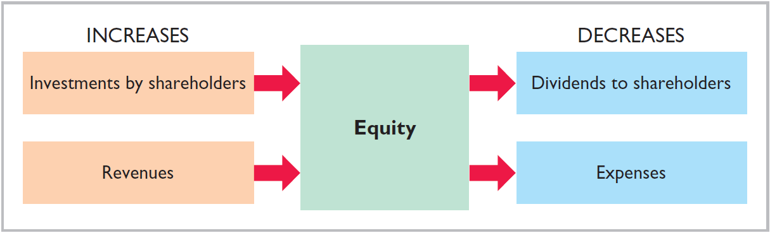
Equity
Illustration 1-7
Increases and decreases in equity
Investments by shareholders represent the total amount paid in by shareholders for the ordinary shares they purchase.
LO 6

Slide 36
Stockholders’ Equity
Illustration 1-7
Increases and decreases in equity
Revenues result from business activities entered into for the purpose of earning income.
Common sources of revenue are: sales, fees, services, commissions, interest, dividends, royalties, and rent.
LO 6

Slide 37
Stockholders’ Equity
Illustration 1-7
Increases and decreases in equity
Expenses are the cost of assets consumed or services used in the process of earning revenue.
Common expenses are: salaries expense, rent expense, utilities expense, property tax expense, etc.
LO 6

Slide 38
Stockholders’ Equity
Illustration 1-7
Increases and decreases in equity
Dividends are the distribution of cash or other assets to shareholders.
Dividends reduce retained earnings. However, dividends are not expenses.
LO 6

Slide 39
>
DO IT!
Classify the following items as issuance of stock, dividends, revenues, or expenses. Then indicate whether each item increases or decreases stockholders’ equity.
Classification
Effect on Equity
Rent Expense
Service Revenue
Dividends
Salaries and Wages Expense
Expense
Decrease
Revenue
Increase
Dividends
Decrease
Expense
Decrease
LO 6

Slide 40
The Basic Accounting Equation
Learning Objective 7 Analyze the effects of business transactions on the accounting equation.
Transactions are a business’s economic
events recorded by accountants.
May be external or internal.
Not all activities represent transactions.
Each transaction has a dual effect on the accounting equation.
LO 7

Slide 41


Transaction Analysis
Illustration: Are the following events recorded in the accounting records?
Discuss product design with potential customer
Purchase computer
Event
Pay rent
Criterion
Is the financial position (assets, liabilities, or stockholder’s equity) of the company changed?
Record/
Don’t Record
Illustration 1-8
Transaction-identification process
LO 7

Slide 42
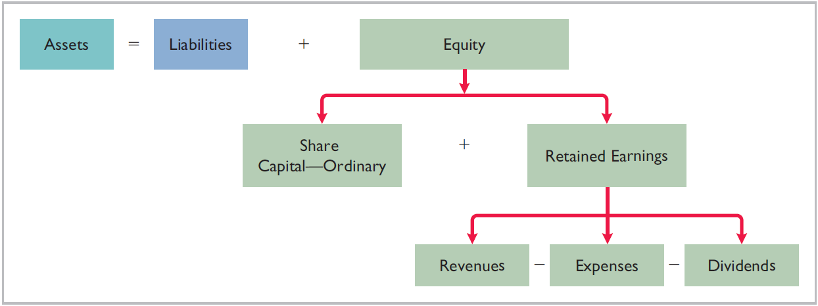
Transaction Analysis
Illustration 1-9
Expanded accounting equation
LO 7

Slide 43
Transaction Analysis
TRANSACTION 1. INVESTMENT BY STOCKHOLDERS Ray and Barbara Neal decide to start a smartphone app development company that they incorporate as Softbyte SA. On September 1, 2017, they invest €15,000 cash in the business in exchange for €15,000 of ordinary shares. The ordinary shares indicates the ownership interest that the Neals have in Softbyte SA. This transaction results in an equal increase in both assets and equity.
Illustration 1-10
Assets = Liabilities + Equity
Trans-
action
Cash
+
Accounts
Receivable
+
Supplies
+
Equipment
=
Accounts
Payable
+
Share Capital
Retained Earnings
Rev. – Exp. – Div.
+
1. +15,000 +15,000
LO 7

Slide 44
TRANSACTION 2. PURCHASE OF EQUIPMENT FOR CASH Softbyte SA purchases computer equipment for €7,000 cash.
Illustration 1-10
Assets = Liabilities + Equity
Trans-
action
Cash
+
Accounts
Receivable
+
Supplies
+
Equipment
=
Accounts
Payable
+
Share Capital
Retained Earnings
Rev. – Exp. – Div.
+
1. +15,000 +15,000
2. -7,000 +7,000
3. +1,600 +1,600
4. +1,200 +1,200
5. +250 -250
6. +1,500 +2,000 +3,500
7. -1,700 -600
-900
-200
8. -250 -250
9. +600 -600
10. -1,300 -1,300
+
+
+
=
+
+
-
-
$8,050 $1,400 $1,600 $7,000 $1,600 $15,000 $4,700 $1,950 $1,300
LO 7

Slide 45
TRANSACTION 3. PURCHASE OF SUPPLIES ON CREDIT Softbyte SA purchases for €1,600 headsets and other accessories expected to last several months. The supplier allows Softbyte to pay this bill in October.
Illustration 1-10
Assets = Liabilities + Equity
Trans-
action
Cash
+
Accounts
Receivable
+
Supplies
+
Equipment
=
Accounts
Payable
+
Share Capital
Retained Earnings
Rev. – Exp. – Div.
+
1. +15,000 +15,000
2. -7,000 +7,000
3. +1,600 +1,600
4. +1,200 +1,200
5. +250 -250
6. +1,500 +2,000 +3,500
7. -1,700 -600
-900
-200
8. -250 -250
9. +600 -600
10. -1,300 -1,300
+
+
+
=
+
+
-
-
$8,050 $1,400 $1,600 $7,000 $1,600 $15,000 $4,700 $1,950 $1,300
LO 7

Slide 46
TRANSACTION 4. SERVICES PERFORMED FOR CASH Softbyte SA receives €1,200 cash from customers for app development services it has performed.
Illustration 1-10
Assets = Liabilities + Equity
Trans-
action
Cash
+
Accounts
Receivable
+
Supplies
+
Equipment
=
Accounts
Payable
+
Share Capital
Retained Earnings
Rev. – Exp. – Div.
+
1. +15,000 +15,000
2. -7,000 +7,000
3. +1,600 +1,600
4. +1,200 +1,200
5. +250 -250
6. +1,500 +2,000 +3,500
7. -1,700 -600
-900
-200
8. -250 -250
9. +600 -600
10. -1,300 -1,300
+
+
+
=
+
+
-
-
$8,050 $1,400 $1,600 $7,000 $1,600 $15,000 $4,700 $1,950 $1,300
LO 7

Slide 47
TRANSACTION 5. PURCHASE OF ADVERTISING ON CREDIT Softbyte SA receives a bill for €250 from the Programming News for advertising on its website but postpones payment until a later date.
Illustration 1-10
Assets = Liabilities + Equity
Trans-
action
Cash
+
Accounts
Receivable
+
Supplies
+
Equipment
=
Accounts
Payable
+
Share Capital
Retained Earnings
Rev. – Exp. – Div.
+
1. +15,000 +15,000
2. -7,000 +7,000
3. +1,600 +1,600
4. +1,200 +1,200
5. +250 -250
6. +1,500 +2,000 +3,500
7. -1,700 -600
-900
-200
8. -250 -250
9. +600 -600
10. -1,300 -1,300
+
+
+
=
+
+
-
-
$8,050 $1,400 $1,600 $7,000 $1,600 $15,000 $4,700 $1,950 $1,300
LO 7

Slide 48
TRANSACTION 6. SERVICES PROVIDED FOR CASH AND CREDIT. Softbyte provides €3,500 of services. The company receives cash of €1,500 from customers, and it bills the balance of €2,000 on account.
Illustration 1-10
Assets = Liabilities + Equity
Trans-
action
Cash
+
Accounts
Receivable
+
Supplies
+
Equipment
=
Accounts
Payable
+
Share Capital
Retained Earnings
Rev. – Exp. – Div.
+
1. +15,000 +15,000
2. -7,000 +7,000
3. +1,600 +1,600
4. +1,200 +1,200
5. +250 -250
6. +1,500 +2,000 +3,500
7. -1,700 -600
-900
-200
8. -250 -250
9. +600 -600
10. -1,300 -1,300
+
+
+
=
+
+
-
-
$8,050 $1,400 $1,600 $7,000 $1,600 $15,000 $4,700 $1,950 $1,300
LO 7

Slide 49
TRANSACTION 7. PAYMENT OF EXPENSES Softbyte SA pays the following expenses in cash for September: office rent €600, salaries and wages of employees €900, and utilities €200.
Illustration 1-10
Assets = Liabilities + Equity
Trans-
action
Cash
+
Accounts
Receivable
+
Supplies
+
Equipment
=
Accounts
Payable
+
Share Capital
Retained Earnings
Rev. – Exp. – Div.
+
1. +15,000 +15,000
2. -7,000 +7,000
3. +1,600 +1,600
4. +1,200 +1,200
5. +250 -250
6. +1,500 +2,000 +3,500
7. -1,700 -600
-900
-200
8. -250 -250
9. +600 -600
10. -1,300 -1,300
+
+
+
=
+
+
-
-
$8,050 $1,400 $1,600 $7,000 $1,600 $15,000 $4,700 $1,950 $1,300
LO 7

Slide 50
TRANSACTION 8. PAYMENT OF ACCOUNTS PAYABLE Softbyte SA pays its €250 Programming News bill in cash. The company previously (in Transaction 5) recorded the bill as an increase in Accounts Payable.
Illustration 1-10
Assets = Liabilities + Equity
Trans-
action
Cash
+
Accounts
Receivable
+
Supplies
+
Equipment
=
Accounts
Payable
+
Share Capital
Retained Earnings
Rev. – Exp. – Div.
+
1. +15,000 +15,000
2. -7,000 +7,000
3. +1,600 +1,600
4. +1,200 +1,200
5. +250 -250
6. +1,500 +2,000 +3,500
7. -1,700 -600
-900
-200
8. -250 -250
9. +600 -600
10. -1,300 -1,300
+
+
+
=
+
+
-
-
$8,050 $1,400 $1,600 $7,000 $1,600 $15,000 $4,700 $1,950 $1,300
LO 7

Slide 51
TRANSACTION 9. RECEIPT OF CASH ON ACCOUNT Softbyte SA receives €600 in cash from customers who had been billed for services (in Transaction 6).
Illustration 1-10
Assets = Liabilities + Equity
Trans-
action
Cash
+
Accounts
Receivable
+
Supplies
+
Equipment
=
Accounts
Payable
+
Share Capital
Retained Earnings
Rev. – Exp. – Div.
+
1. +15,000 +15,000
2. -7,000 +7,000
3. +1,600 +1,600
4. +1,200 +1,200
5. +250 -250
6. +1,500 +2,000 +3,500
7. -1,700 -600
-900
-200
8. -250 -250
9. +600 -600
10. -1,300 -1,300
+
+
+
=
+
+
-
-
$8,050 $1,400 $1,600 $7,000 $1,600 $15,000 $4,700 $1,950 $1,300
LO 7

Slide 52
TRANSACTION 10. DIVIDENDS The corporation pays a dividend of €1,300 in cash to Ray and Barbara Neal, the shareholders of Softbyte SA.
Illustration 1-10
Assets = Liabilities + Equity
Trans-
action
Cash
+
Accounts
Receivable
+
Supplies
+
Equipment
=
Accounts
Payable
+
Share Capital
Retained Earnings
Rev. – Exp. – Div.
+
1. +15,000 +15,000
2. -7,000 +7,000
3. +1,600 +1,600
4. +1,200 +1,200
5. +250 -250
6. +1,500 +2,000 +3,500
7. -1,700 -600
-900
-200
8. -250 -250
9. +600 -600
10. -1,300 -1,300
+
+
+
=
+
+
-
-
€8,050 €1,400 €1,600 €7,000 €1,600 €15,000 €4,700 €1,950 €1,300
€18,050
€18,050
LO 7

Slide 53
Summary of Transactions
Each transaction must be analyzed in terms of its effect on:
The three components of the basic accounting equation.
Specific types (kinds) of items within each component.
The two sides of the equation must always be equal.
The Share Capital—Ordinary and Retained Earnings columns indicate the causes of each change in the shareholders’ claim on assets.
LO 7

Slide 54
>
DO IT!
Transactions made by Virmari & Co. SA, a public accounting firm, for the month of August are shown below. Prepare a tabular analysis which shows the effects of these transactions on the expanded accounting equation, similar to that shown in Illustration 1-10.
The company issued ordinary shares for €25,000 cash.
The company purchased €7,000 of office equipment on credit.
The company received €8,000 cash in exchange for services performed.
The company paid €850 for this month’s rent.
The company paid a dividend of €1,000 in cash to shareholders.
LO 7

Slide 55
>
DO IT!
The company issued ordinary shares for €25,000 cash.
Assets = Liabilities + Equity
Trans-
action
Cash
+
Equipment
=
Accounts
Payable
+
Share Capital
+
Retained Earnings
Rev. – Exp. – Div.
1. +25,000 +25,000
2. +7,000 +7,000
3. +8,000 +8,000
4. -850 -850
5. -1,000 -1,000
+
=
+
+
-
-
$31,150 $7,000 $7,000 $25,000 $8,000 $850 $1,000
$18,050
$18,050
LO 7

Slide 56
>
DO IT!
The company purchased €7,000 of office equipment on credit.
Assets = Liabilities + Equity
Trans-
action
Cash
+
Equipment
=
Accounts
Payable
+
Share Capital
+
Retained Earnings
Rev. – Exp. – Div.
1. +25,000 +25,000
2. +7,000 +7,000
3. +8,000 +8,000
4. -850 -850
5. -1,000 -1,000
+
=
+
+
-
-
$31,150 $7,000 $7,000 $25,000 $8,000 $850 $1,000
$18,050
$18,050
LO 7

Slide 57
>
DO IT!
The company received €8,000 cash in exchange for services performed.
Assets = Liabilities + Equity
Trans-
action
Cash
+
Equipment
=
Accounts
Payable
+
Share Capital
+
Retained Earnings
Rev. – Exp. – Div.
1. +25,000 +25,000
2. +7,000 +7,000
3. +8,000 +8,000
4. -850 -850
5. -1,000 -1,000
+
=
+
+
-
-
$31,150 $7,000 $7,000 $25,000 $8,000 $850 $1,000
$18,050
$18,050
LO 7

Slide 58
>
DO IT!
The company paid €850 for this month’s rent.
Assets = Liabilities + Equity
Trans-
action
Cash
+
Equipment
=
Accounts
Payable
+
Share Capital
+
Retained Earnings
Rev. – Exp. – Div.
1. +25,000 +25,000
2. +7,000 +7,000
3. +8,000 +8,000
4. -850 -850
5. -1,000 -1,000
+
=
+
+
-
-
$31,150 $7,000 $7,000 $25,000 $8,000 $850 $1,000
$18,050
$18,050
LO 7

Slide 59
>
DO IT!
The company paid a dividend of €1,000 in cash to shareholders.
Assets = Liabilities + Equity
Trans-
action
Cash
+
Equipment
=
Accounts
Payable
+
Share Capital
+
Retained Earnings
Rev. – Exp. – Div.
1. +25,000 +25,000
2. +7,000 +7,000
3. +8,000 +8,000
4. -850 -850
5. -1,000 -1,000
+
=
+
+
-
-
€31,150 €7,000 €7,000 €25,000 €8,000 €850 €1,000
€38,150
€38,150
LO 7

Slide 60
The Basic Accounting Equation
Learning Objective 8 Understand the five financial statements and how they are prepared.
Companies prepare five financial statements :
Income Statement
Retained Earnings Statement
Statement of Financial Position
Statement of Cash Flows
Comprehensive Income Statement
LO 8

Slide 61
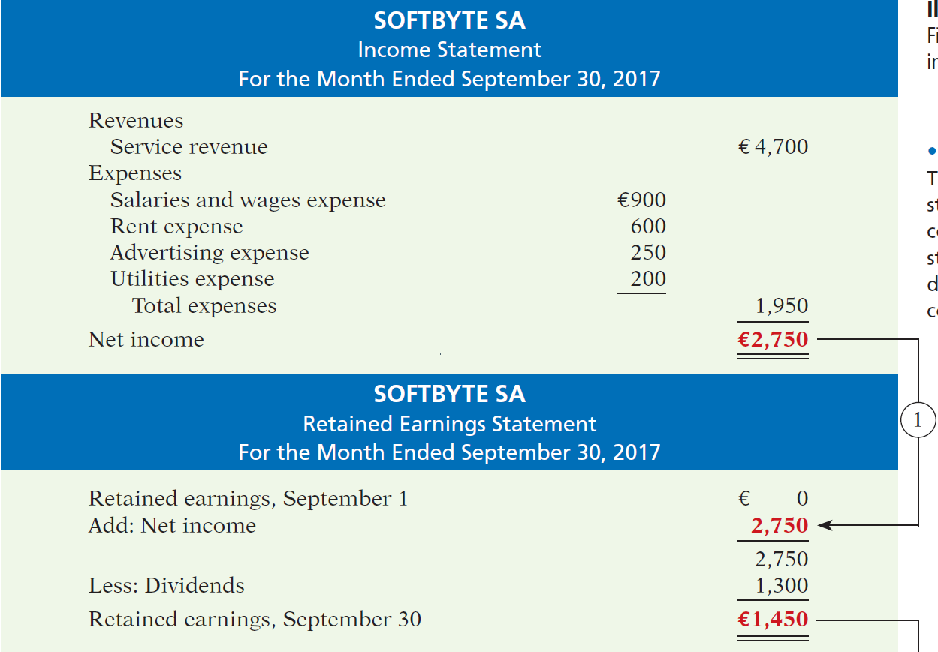
Illustration 1-10
Financial statements and
their interrelationships
Illustration 1-11
Financial statements and their interrelationships
LO 8

Slide 62
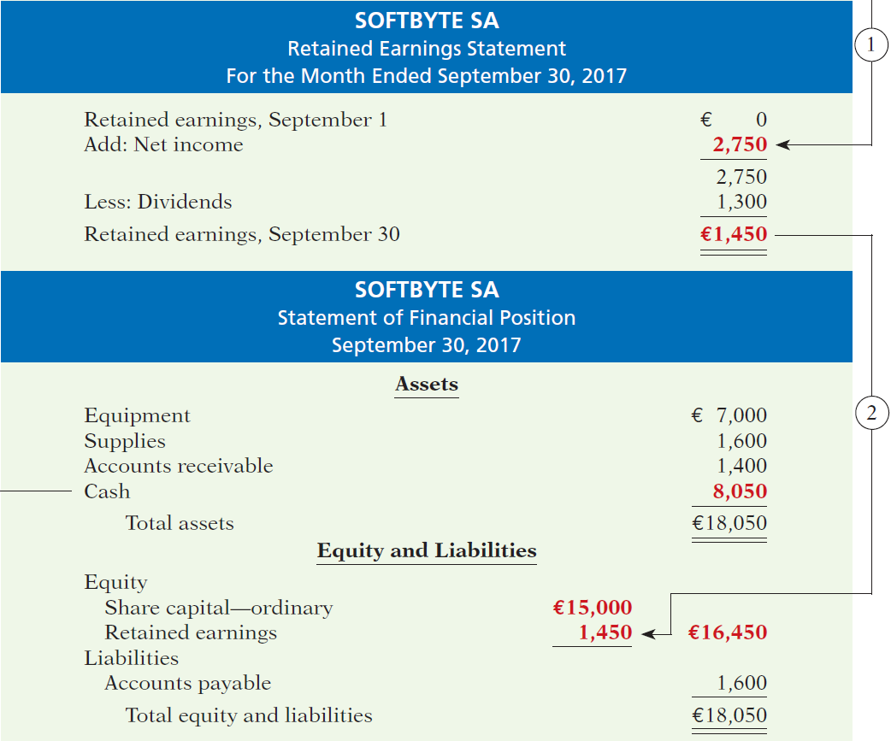
LO 8
Illustration 1-11

Slide 63
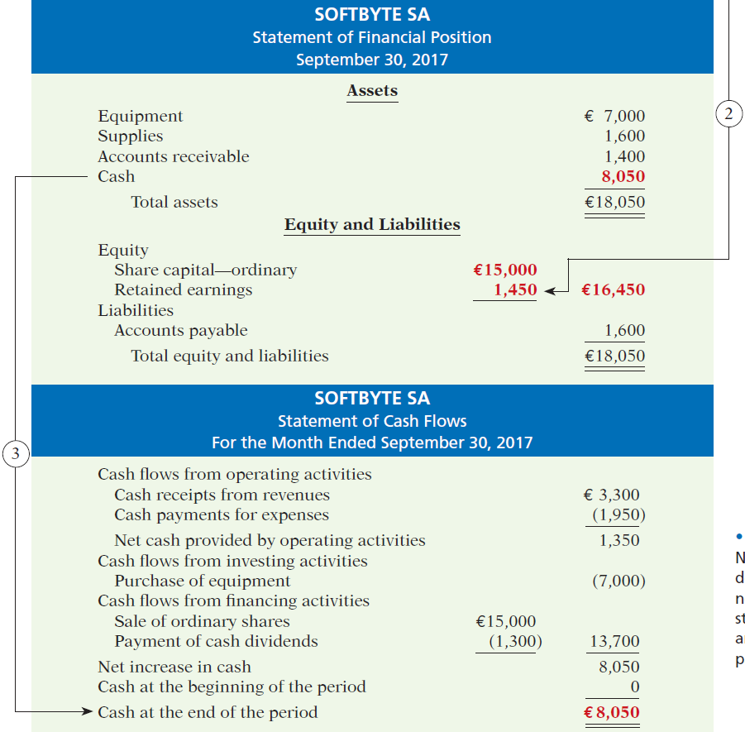
Balance sheet and income statement are needed to prepare statement of cash flows.
Illustration 1-11
Financial statements and their interrelationships
LO 8

Slide 64
Income Statement
Reports the profitability of the company’s operations over a specific period of time.
Lists revenues first, followed by expenses.
Shows net income (or net loss).
Does not include investment and dividend transactions between the shareholders and the business.
LO 8

Slide 65
Financial Statements
Review Question
Net income will result during a time period when:
assets exceed liabilities.
assets exceed revenues.
expenses exceed revenues.
revenues exceed expenses.
LO 8

Slide 66
Retained Earnings Statement
Reports the changes in retained earnings for a specific period of time.
The time period is the same as that covered by the income statement.
Information provided indicates the reasons why retained earnings increased or decreased during the period.
LO 8

Slide 67
Statement of Financial Position
Reports the assets, liabilities, and equity at a specific date.
Lists assets at the top, followed by liabilities and equity.
Total assets must equal total liabilities and equity.
Is a snapshot of the company’s financial condition at a specific moment in time (usually the month-end or year-end).
LO 8

Slide 68
Financial Statements
Review Question
The financial statement that reports assets, liabilities, and equity is the:
income statement.
retained earnings statement.
statement of financial position.
statement of cash flows.
LO 8

Slide 69
Accounting Across the Organization
A Wise End Vodafone (GBR)
Not every company uses December 31 as the accounting year-end. Some companies whose year-ends differ from December 31 are Vodafone Group (GBR), March 31; Walt Disney Productions (USA), September 30; and JJB Sports (GBR), the Sunday that falls before, but closest to, January 31. Why do companies choose the particular year-ends that they do? Many opt to end the accounting year when inventory or operations are at a low. Compiling accounting information requires much time and effort by managers, so companies would rather do it when they aren’t as busy operating the business. Also, inventory is easier and less costly to count when it is low.
LO 8

Slide 70
Statement of Cash Flows
Information on the cash receipts and payments for a specific period of time.
Answers the following:
Where did cash come from?
What was cash used for?
What was the change in the
cash balance?
HELPFUL HINT
Investing activities pertain to investments made by the company, not investments made by the owners.
LO 8

Slide 71
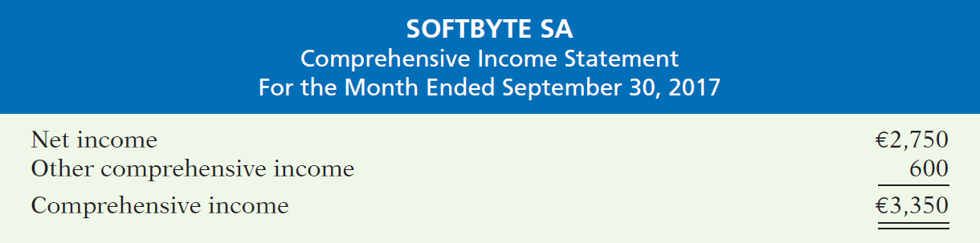
Comprehensive Income Statement
Other comprehensive income items are not part of net income.
Reported either by
Combining with income statement, or
Separate statement.
Illustration 1-13
Comprehensive income statement
LO 8

Slide 72
People, Planet, and Profit Insight
Beyond Financial Statements
Should we expand our financial statements beyond the income statement, retained earnings statement, statement of financial position, and statement of cash flows? Some believe we should take into account ecological and social performance, in addition to financial results, in evaluating a company. The argument is that a company’s responsibility lies with anyone who is influenced by its actions. In other words, a company should be interested in benefiting many different parties, instead of only maximizing shareholders’ interests. A socially responsible business does not exploit or endanger any group of individuals. It follows fair trade practices, provides safe environments for workers, and bears responsibility for environmental damage. Granted, measurement of these factors is difficult. How to report this information is also controversial. But, many interest in and useful efforts are underway. Throughout this textbook, we provide additional insights into how companies are attempting to meet the challenge of measuring and reporting their contributions to society, as well as their financial results, to shareholders.
LO 8

Slide 73
>
DO IT!
Presented below is selected information related to Flanagan Group plc at December 31, 2017. Flanagan reports financial information monthly.
Equipment £10,000 Utilities Expense £ 4,000
Cash 8,000 Accounts Receivable 9,000
Service Revenue 36,000 Salaries and Wages Expense 7,000
Rent Expense 11,000 Notes Payable 16,500
Accounts Payable 2,000 Dividends 5,000
(a) Determine the total assets of Flanagan at December 31, 2017.
(b) Determine the net income that Flanagan reported for December 2017.
(c) Determine the equity of Flanagan at December 31, 2017.
LO 8

Slide 74
Information related to Flanagan Group plc at December 31, 2017.
Equipment £10,000 Utilities Expense £ 4,000
Cash 8,000 Accounts Receivable 9,000
Service Revenue 36,000 Salaries and Wages Expense 7,000
Rent Expense 11,000 Notes Payable 16,500
Accounts Payable 2,000 Dividends 5,000
(a) Determine the total assets of Flanagan at December 31, 2017.
Equipment £10,000
Cash 8,000
Accounts Receivable 9,000
Total assets £27,000
LO 8

Slide 75
Information related to Flanagan Group plc at December 31, 2017.
Equipment £10,000 Utilities Expense £ 4,000
Cash 8,000 Accounts Receivable 9,000
Service Revenue 36,000 Salaries and Wages Expense 7,000
Rent Expense 11,000 Notes Payable 16,500
Accounts Payable 2,000 Dividends 5,000
(b) Determine the net income reported for December 2017.
Revenues
Service revenue £36,000
Expenses
Rent expense £11,000
Salaries and wages expense 7,000
Utilities expense 4,000
Total expenses 22,000
Net income £14,000
LO 8

Slide 76
Information related to Flanagan Group plc at December 31, 2017.
Equipment £10,000 Utilities Expense £ 4,000
Cash 8,000 Accounts Receivable 9,000
Service Revenue 36,000 Salaries and Wages Expense 7,000
Rent Expense 11,000 Notes Payable 16,500
Accounts Payable 2,000 Dividends 5,000
(c) Determine the equity of Flanagan at December 31, 2017.
Total assets [as computed in (a)] £27,000
Less: Liabilities
Notes payable £16,500
Accounts payable 2,000 18,500
Equity £ 8,500
LO 8

Slide 77
APPENDIX 1A
Accounting Career Opportunities
Learning Objective 9 Explain the career opportunities in accounting.
Public Accounting
Careers in auditing, taxation, and management consulting serving the general public.
Private Accounting
Careers in industry working in cost accounting, budgeting, accounting information systems, and taxation.
Governmental Accounting
Careers with the tax authorities, law enforcement agencies, and corporate regulators.
Forensic Accounting
Uses accounting, auditing, and investigative skills to conduct investigations into theft and fraud.
LO 9

Slide 78
A Look at U.S. GAAP
Learning Objective 10
Describe the impact of IFRS on U.S. financial reporting.
Key Points
Most agree that there is a need for one set of international
accounting standards. Here is why:
Multinational corporations. Today’s companies view the entire world as their market. For example, large companies often generate more than 50% of their sales outside their own boundaries.
Mergers and acquisitions. The mergers between Fiat/Chrysler and Vodafone/Mannesmann suggest that we will see even more such business combinations in the future.
Information technology. As communication barriers continue to topple through advances in technology, companies and individuals in different countries and markets are becoming more comfortable buying and selling goods and services from one another.
LO 10

Slide 79
A Look at U.S. GAAP
Key Points
Financial markets. Financial markets are of international significance today. Whether it is currency, equity securities (shares), bonds, or derivatives, there are active markets throughout the world trading these types of instruments.
Similarities
GAAP is based on a conceptual framework that is similar to that used to develop IFRS.
The three common forms of business organization that are presented in the chapter, proprietorships, partnerships, and corporations, are also found in the United States. Because the choice of business organization is influenced by factors such as legal environment, tax rates and regulations, and degree of entrepreneurism, the relative use of each form will vary across countries.
LO 10

Slide 80
A Look at U.S. GAAP
Similarities
Transaction analysis is basically the same under IFRS and GAAP but, as you will see in later chapters, the different standards may impact how transactions are recorded.
Financial frauds have occurred at companies such as Satyam Computer Services (IND), Parmalat (ITA), and Royal Ahold (NLD). They have also occurred at large U.S. companies such as Enron, WorldCom, and AIG.
LO 10

Slide 81
A Look at U.S. GAAP
Differences
The Sarbanes-Oxley Act (SOX) mandates certain internal controls for large public companies listed on U.S. exchanges. There is a continuing debate as to whether non-U.S. companies should have to comply with this extra layer of regulation. Debate about international companies (non-U.S.) adopting SOX-type standards centers on whether the benefits exceed the costs. The concern is that the higher costs of SOX compliance are making the U.S. securities markets less competitive.
U.S. regulators have recently eliminated the need for foreign companies that trade shares in U.S. markets to reconcile their accounting with GAAP.
IFRS tends to be less detailed in its accounting and disclosure requirements than GAAP. This difference in approach has resulted in a debate about the merits of “principles-based” (IFRS) versus “rules-based” (GAAP) standards.
LO 10

Slide 82
A Look at U.S. GAAP
Looking to the Future
Both the IASB and the FASB are hard at work developing standards that will lead to the elimination of major differences in the way certain transactions are accounted for and reported. Consider, for example, that as a result of a joint project on the conceptual framework, the definitions of the most fundamental elements (assets, liabilities, equity, revenues, and expenses) may actually change. However, whether the IASB adopts internal control provisions similar to those in SOX remains to be seen.
LO 10

Slide 83
A Look at U.S. GAAP
A Look at IFRS
IFRS Self-Test Questions
Which of the following is not a reason why a single set of high-quality international accounting standards would be beneficial?
Mergers and acquisition activity.
Financial markets.
Multinational corporations.
GAAP is widely considered to be a superior reporting system.
LO 10

Slide 84
A Look at U.S. GAAP
A Look at IFRS
IFRS Self-Test Questions
The Sarbanes-Oxley Act determines:
international tax regulations.
internal control standards as enforced by the IASB.
internal control standards of U.S. publicly traded companies.
U.S. tax regulations.
LO 10

Slide 85
A Look at U.S. GAAP
A Look at IFRS
IFRS Self-Test Questions
IFRS is considered to be more:
principles-based and less rules-based than GAAP.
rules-based and less principles-based than GAAP.
detailed than GAAP.
None of the above.
LO 10

